Slide 1

AdventureWorks
Executive Summary

Slide 2
Performance SUMMARY on sales from 2001 to 2004
Total Sales was about $109, 846 381 million and total standard costs were around $104million.
The business managed to make Net Sales worth of around $9million.
Current ProductCategories are Bikes, Components, Accessories and Clothing.
Bikes are the top selling Product Category throughout the 3 years.
The AWC logo Cap is the Top Product by orders and Mountain-200 Black 38 is the Top Product by Sales for the 3 years.

Slide 3
What will cover
A review of prior years performance
Products
Sales regions

Slide 4
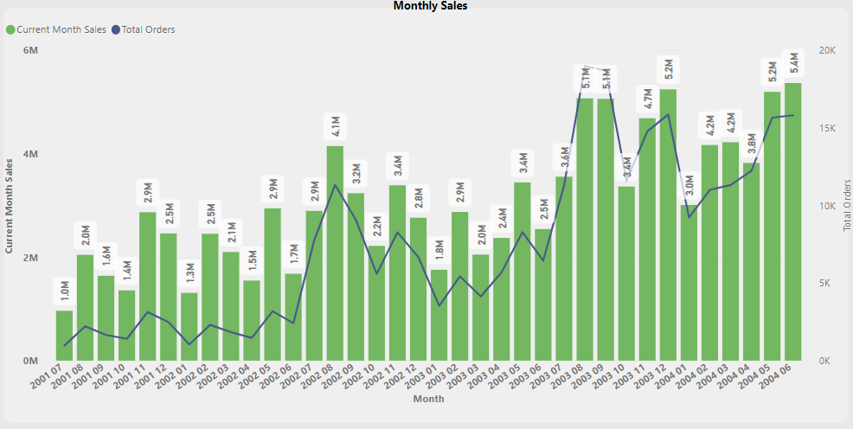
Overall SALES PERFOMANCE
There’s a notable growth in Sales from month 6 to month 8 in every year which could be as a result of the summer breaks within North America and Europe.

Slide 5
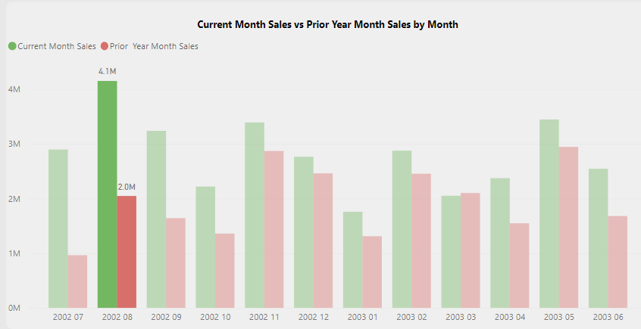
Financial YEAR 1
In the first financial year, the sales were below 2million and they went up during the start of the second financial year in August 2002 by double,

Slide 6
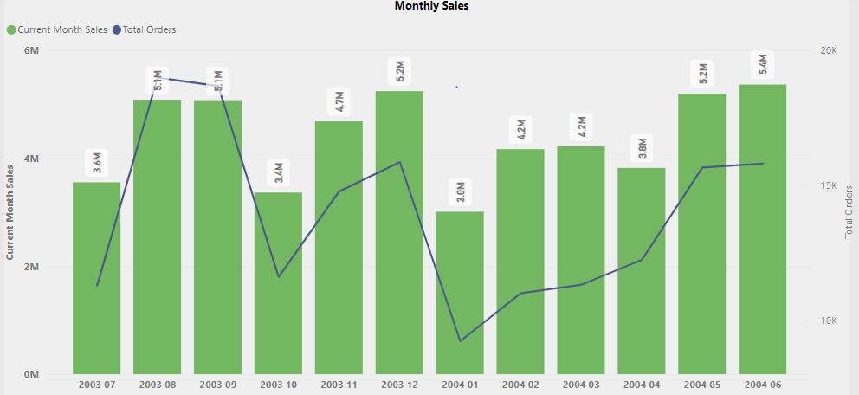
Financial year 3
Almost 70% of the Sales are from Financial year 3.
There’s been a double improvement in Sales, the highest recorded being in June, 2004 of about 5.4 million.

Slide 7
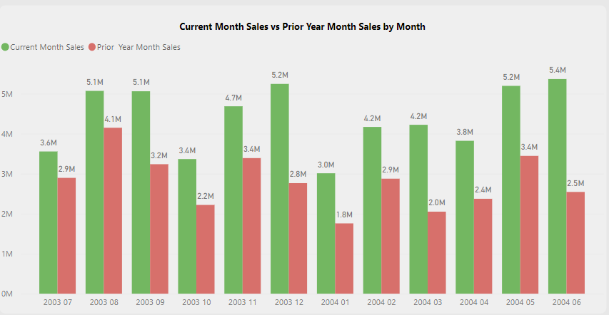
Prior year performance
In the financial year 3, comparing to prior year month sales, the business performed well to a point that other months were double the sales.

Slide 8
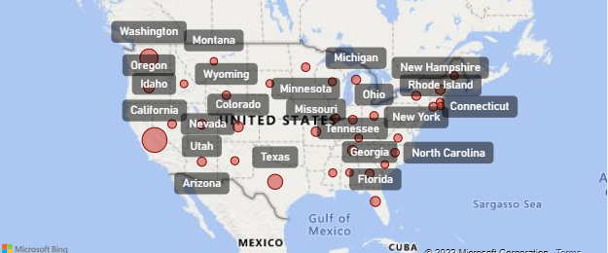
Sales performance in REGIONS
United States has the highest recorded Sales throughout the 3 years. The highest sales being in the month of August.
California is contributing almost 21% of the monthly sales in United States.
France and United Kingdom are the least performing on the overall Sales.

Slide 9
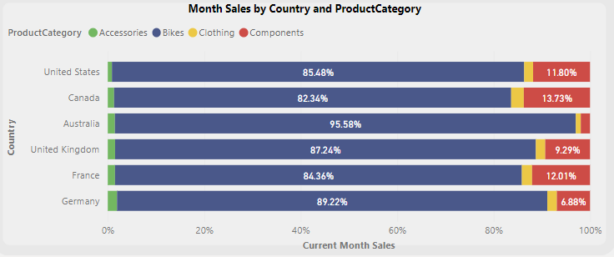
Products and REGIONS
Australia and Germany are selling less on Clothing and Components.

Slide 10
Recommendations
The company needs to intensify it’s marketing campaigns around this period to maximise on potential sales.
The company must consider promoting advertising and marketing in Australia and Germany particularly on Clothing and Components to increased revenues within those categories.

Slide 11
Conclusion
The performance is improving as shown increased net sales over the period under review. The net increased from $2,3 million from financial year 1 to $6,15 million. The net sales grew by 282%.
Bikes would continue to make profits and sales for the company if we would do a prediction for the next financial year.
The sale of the other ProductCategories would be highly unpredictable because if we look at the statistics the amount of the profits the company has generated has been dynamic.

